Slide 1
Heuristic Search
Presented By : Snehal Tawar

Slide 2
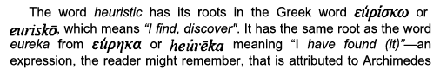
Use Purpose:
The purpose of Heuristic function is to guide the search process in the most profitable path amongst all that are available.
It is a part of Informed Search. Technique designed to solve a problem quickly.
Time saver, avoiding huge calculations
Provides good solution, Not optimal solution

Slide 3
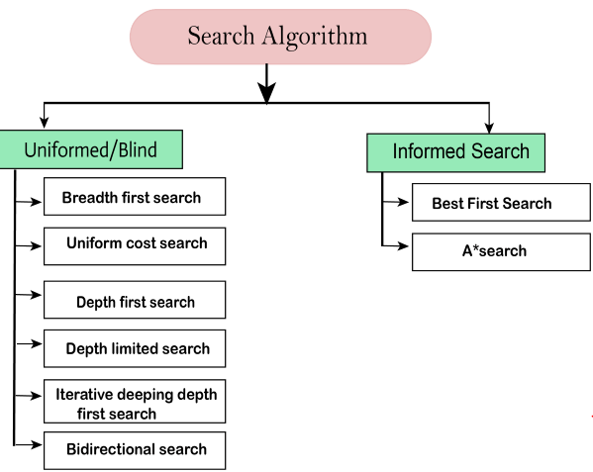
Background:
We can classify the search algorithms into uninformed (Blind search) search and informed search (Heuristic search) algorithms.

Slide 4
Uninformed Search:
It operates in a brute-force way and is called blind search.
Examines each node of the tree until goal node is achieved.
Informed Search:
Problem information is available which can guide to the solution.
A heuristic is a way which might not always be guaranteed for best solutions but guaranteed to find a good solution in reasonable time
Admissibility of the heuristic function is given as:
h(n) <= h*(n)
4. Here h(n) is heuristic cost, and h*(n) is the estimated cost. Hence heuristic cost should be less than or equal to the estimated cost.

Slide 5
Pure Heuristic Search:
Example
Pure heuristic search is the simplest form of heuristic search algorithms. It expands nodes based on their heuristic value h(n).
It maintains two lists, OPEN and CLOSED list. In the CLOSED list, it places those nodes which have already expanded and in the OPEN list, it places nodes which have yet not been expanded.
It has two types:
a) Best First Search Algorithm(Greedy search)
b) A* Search Algorithm
Travelling salesman problem
"Given a list of cities and the distances between each pair of cities, what is the shortest possible route that visits each city and returns to the origin city?"

Slide 6
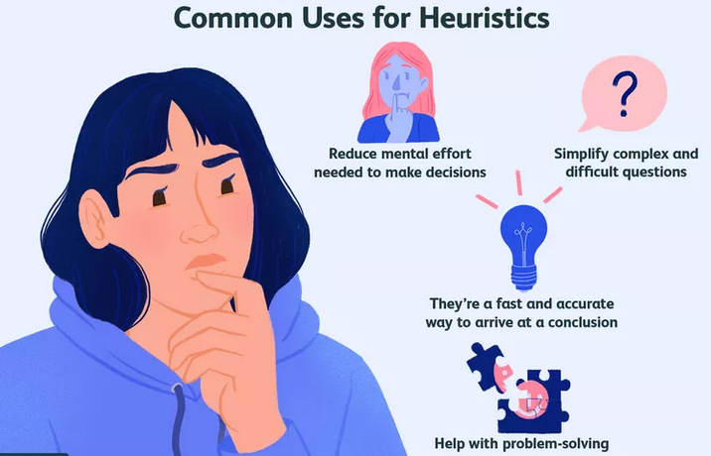
Anti-Virus Software:
Antivirus Software often uses heuristic rules for detecting viruses and other forms of malware. Heuristic scanning looks for code and/or behavioral patterns common to a class or family of viruses, with different sets of rules for different viruses.

Slide 7

Thank You !

